Slide 1
Blacktown Chinese Christian Church
Welcome to Our English Service 03.05.2026
English Service 9:45 – 11:00 am
Worship Songs: Passage: Speaker: Topic: Response Song: Announcements and Closing Prayer Benediction
Who you say I am amazing grace (my chains are gone) rememberance Gal 5:26-6:10 Jose Peter Daily Practice of Freedom

Slide 2
BCCC english service

Slide 3
Who You Say I Am
CCLI Licence No: 5485849

Slide 4
Who am I that the highest King
Would welcome me

Slide 5
I was lost but He brought me in
Oh His love for me
Oh His love for me

Slide 6
Who the Son sets free
Oh is free indeed
I'm a child of God
Yes I am

Slide 7
Free at last, He has ransomed me
His grace runs deep

Slide 8
While I was a slave to sin
Jesus died for me
Yes He died for me

Slide 9
Who the Son sets free
Oh is free indeed
I'm a child of God
Yes I am

Slide 10
In my Father's house
There's a place for me
I'm a child of God
Yes I am

Slide 11
I am chosen, not forsaken
I am who You say I am
You are for me, not against me
I am who You say I am (x2)

Slide 12
I am who You say I am

Slide 13
Who the Son sets free
Oh is free indeed
I'm a child of God
Yes I am

Slide 14
In my Father's house
There's a place for me
I'm a child of God
Yes I am

Slide 15
In my Father's house
There's a place for me
I'm a child of God
Yes I am

Slide 16
Amazing Grace (My Chains Are Gone)
CCLI Licence No: 5485849

Slide 17
Amazing grace, how sweet the sound
That saved a wretch like me
I once was lost, but now I'm found
Was blind, but now I see

Slide 18
'Twas grace that taught my heart to fear
And grace my fears relieved
How precious did that grace appear
The hour I first believed

Slide 19
My chains are gone, I've been set free
My God, my Savior has ransomed me
And like a flood His mercy reigns
Unending love, amazing grace

Slide 20
The Lord has promised good to me
His word my hope secures
He will my shield and portion be
As long as life endures

Slide 21
My chains are gone, I've been set free
My God, my Savior has ransomed me
And like a flood His mercy reigns
Unending love, amazing grace (x2)

Slide 22
The earth shall soon dissolve like snow
The sun forbear to shine
But God who called me here below
Will be forever mine

Slide 23
Will be forever mine
You are forever mine

Slide 24
Remembrance
CCLI Licence No: 5485849

Slide 25
I take the bread of life
Broken for all my sin
Your body crucified
To make me whole again

Slide 26
I will recall the cup
Poured out in sacrifice
To trade this sinner's end
For Your new covenant

Slide 27
Hallelujah
I'll live my life in remembrance
Hallelujah
Your promise I won't forget

Slide 28
I'll walk salvation's road
With fear and trembling
Your way borne as my own
As Christ is formed in me

Slide 29
Hallelujah
I'll live my life in remembrance
Hallelujah
Your promise I won't forget

Slide 30
If ever I should lose my way
If ever I deny Your grace
Remind me of the price You paid

Slide 31
Hallelujah
I'll live in remembrance

Slide 32
You've been so, so good to me
You've been so, so good to me
Oh to think where I would be
If not for You, if not for You (x3)

Slide 33
As far as heights reach from the depths
As far as east is from the west
So far Your grace has carried me

Slide 34
Until I see You face to face
Until at last I've won my race
Remind me You're not finished yet

Slide 35
Hallelujah
Hallelujah
Hallelujah
I'll live in remembrance

Slide 36
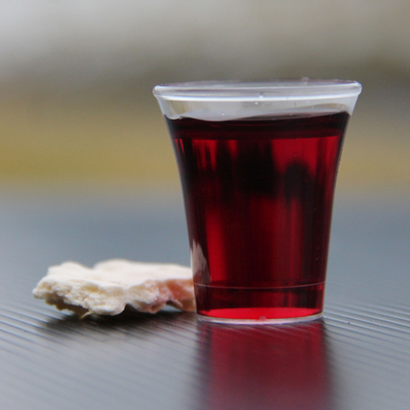
Holy Communion

Slide 37
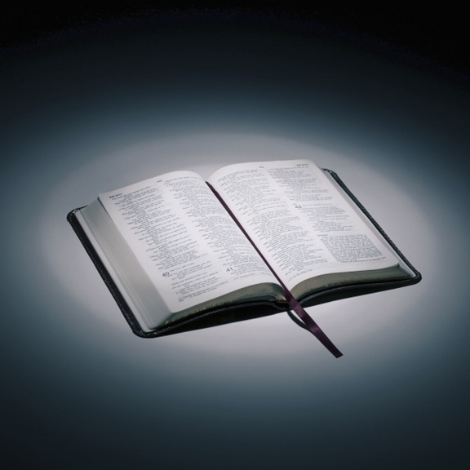
Bible reading

Slide 38
Gal 5:26-6:10
²⁶ Let us not become conceited, provoking and envying each other.
Brothers and sisters, if someone is caught in a sin, you who live by the Spirit should restore that person gently. But watch yourselves, or you also may be tempted. ² Carry each other’s burdens, and in this way you will fulfill the law of Christ.

Slide 39
Gal 5:26-6:10
³ If anyone thinks they are something when they are not, they deceive themselves. ⁴ Each one should test their own actions. Then they can take pride in themselves alone, without comparing themselves to someone else,

Slide 40
Gal 5:26-6:10
⁵ for each one should carry their own load. ⁶ Nevertheless, the one who receives instruction in the word should share all good things with their instructor.

Slide 41
Gal 5:26-6:10
⁷ Do not be deceived: God cannot be mocked. A man reaps what he sows. ⁸ Whoever sows to please their flesh, from the flesh will reap destruction; whoever sows to please the Spirit, from the Spirit will reap eternal life.

Slide 42
Gal 5:26-6:10
⁹ Let us not become weary in doing good, for at the proper time we will reap a harvest if we do not give up. ¹⁰ Therefore, as we have opportunity, let us do good to all people, especially to those who belong to the family of believers.

Slide 43
Announcements

Slide 44





Account name: Blacktown Chinese Christian Church
Account number: 4216 50263
Offering
BSB: 112 - 879
Please put in "offering" as the reference
The offering box is available at the back of the hall

Slide 45
Prayer points

Slide 46
Mingle time!

